Slide 2
A+ Scholarship Program Linda Johns A+ Program & Institutional Scholarships 417-447-6931 johnsl@otc.edu

Slide 3
A+ Student Panel Facilitator Vicki MacDonald Assistant College Director of Admissions College Ambassadors Riley Gautieri David James Emily Henderson Halee Story

Slide 4
A+ is easy to use
Apply for admission to OTC at www.otc.edu
Have your HS send us an official A+ stamped transcript
Register as a full-time student (12 or more credit hours)
Select a program of study
Complete the FAFSA & list OTC as a school to receive info
See A+ checklist on your phone – OTC’s Aplus webpage
www.otc.edu/financialaid/aplus

Slide 5
The registration process is changing for spring 2019
Spring registration begins November 14.
All students MUST sign up for a payment plan by midnight of that same day to hold their spot in those classes.
There is one payment plan for all students. Three payments in the fall & spring semester and two payments for summer.

Slide 6
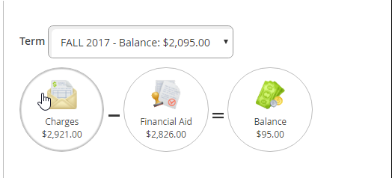
Anticipated Aid
The amount a student owes will be based on their total charges minus their anticipated aid.
After school begins there will be three scheduled payments in fall & spring and two in summer.
Spring 2019: Scheduled payments begin February 5, March 5 & April 5.

Slide 7
A+ covers
Tuition
Common Fees
Registration Fee
Student Fees
Student Tech Fees
Security Fee

Slide 8
Federal Pell Grant must pay first
Tuition
- Pell
= A+ Scholarship
Notes:
First Generation students don’t have the encouragement typically as students whose parents have a college education. The campus offers many resources to help direct students in the right direction.

Slide 9
Length of Eligibility
A+ expires at the earliest of the following:
It’s been 4 years from the date of your HS graduation.
You have graduated with a two year degree…or…
You have completed enough hours it takes to earn a two year degree.
Notes:
Currently 22 work study opportunities available on campus- based on financial need (FAFSA)

Slide 10
Questions?

