Slide 1
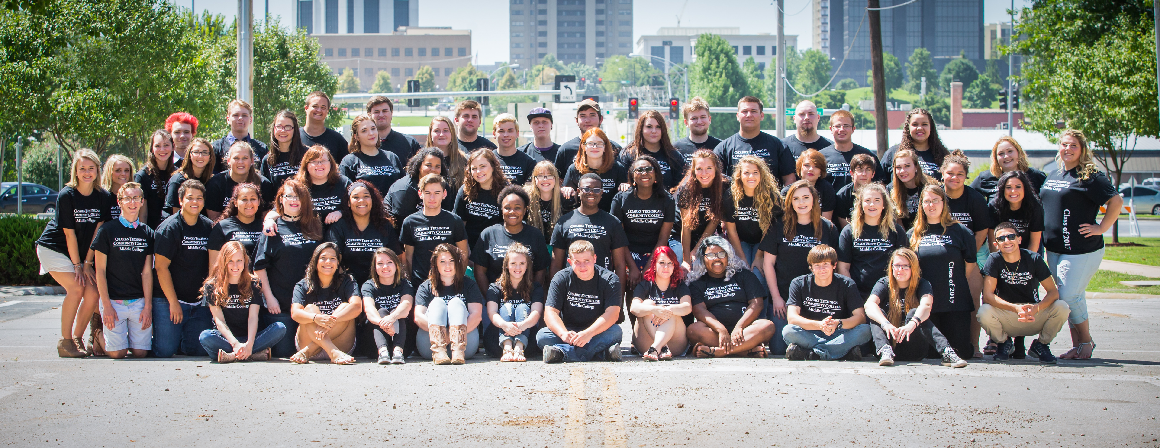

Slide 2
Who Attends Middle College? *Juniors and Seniors in High School * Students looking for a different high school experience * Students who want to go to college early SPS, Republic, Rogersville, Nixa, Sparta

Slide 3
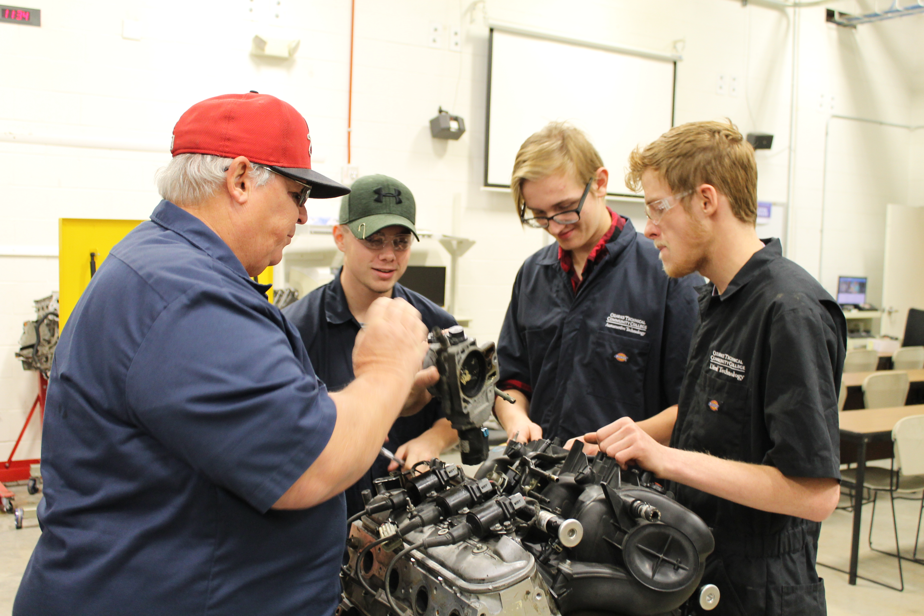
WHAT are they attending? *High School full time on the OTC campus * College classes in Career and Technical education * General education classes for college credit

Slide 4
What do they study?

Slide 5
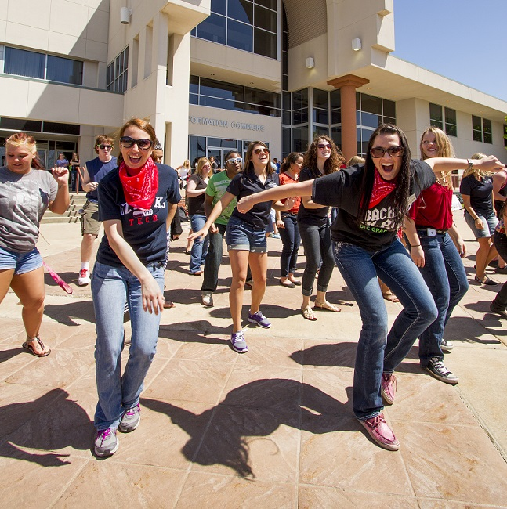
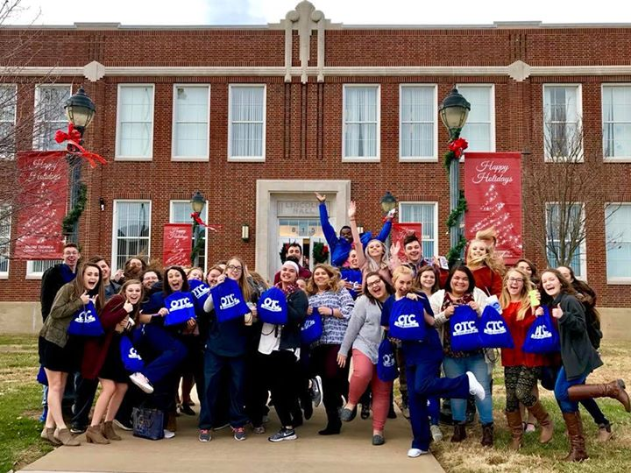
WHERE do Middle College students go?

Slide 6
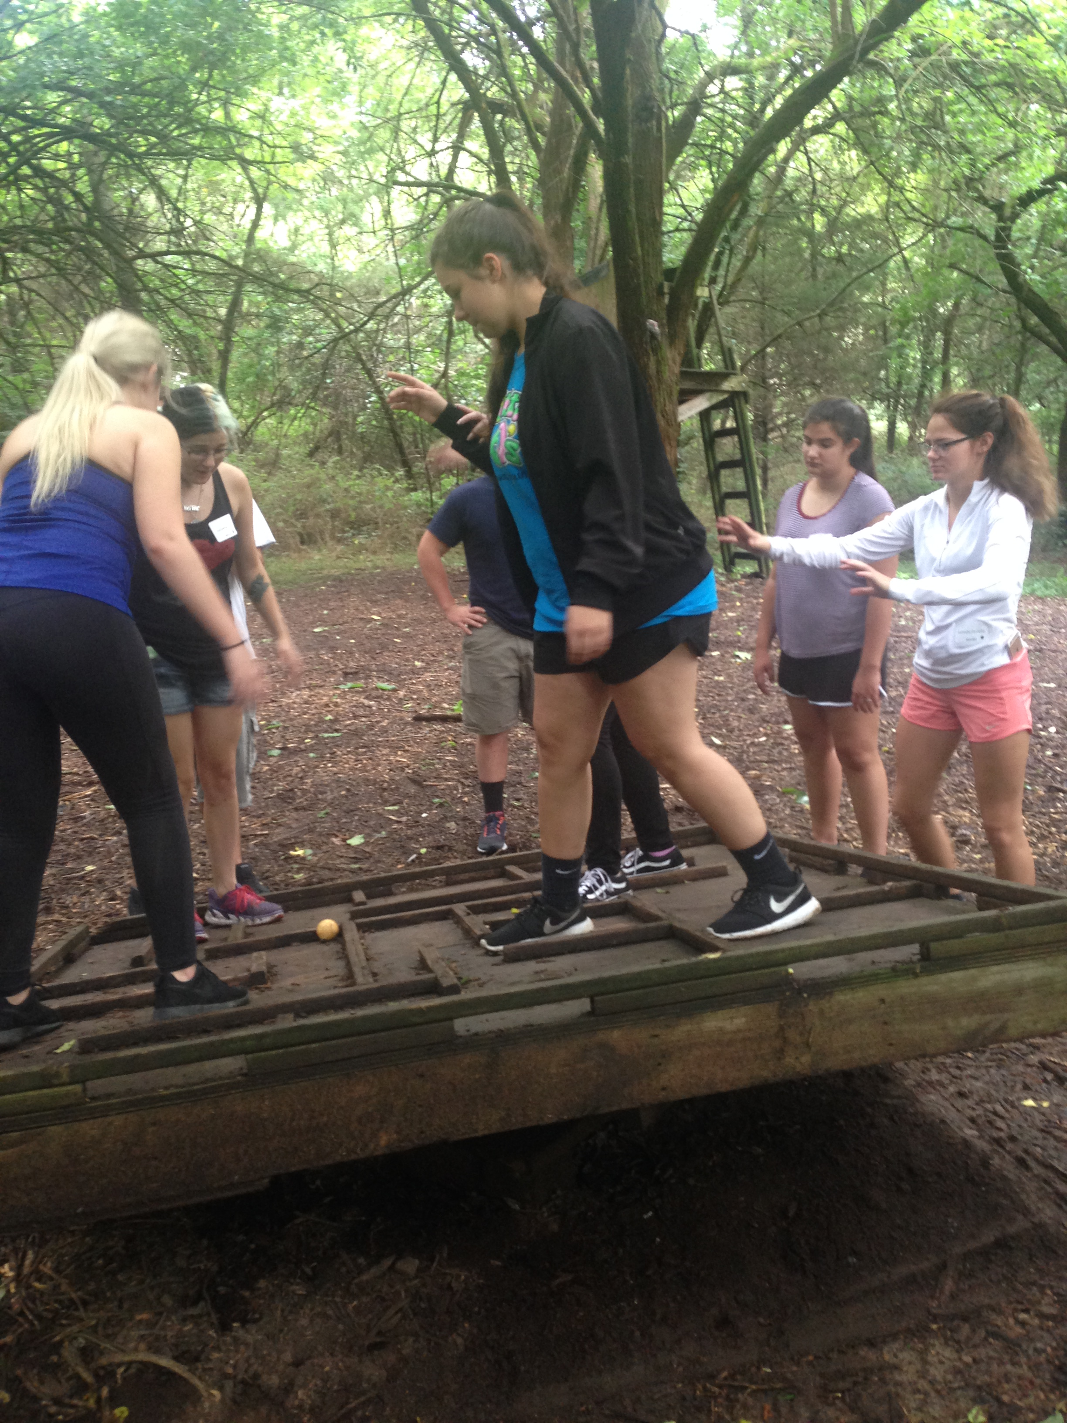
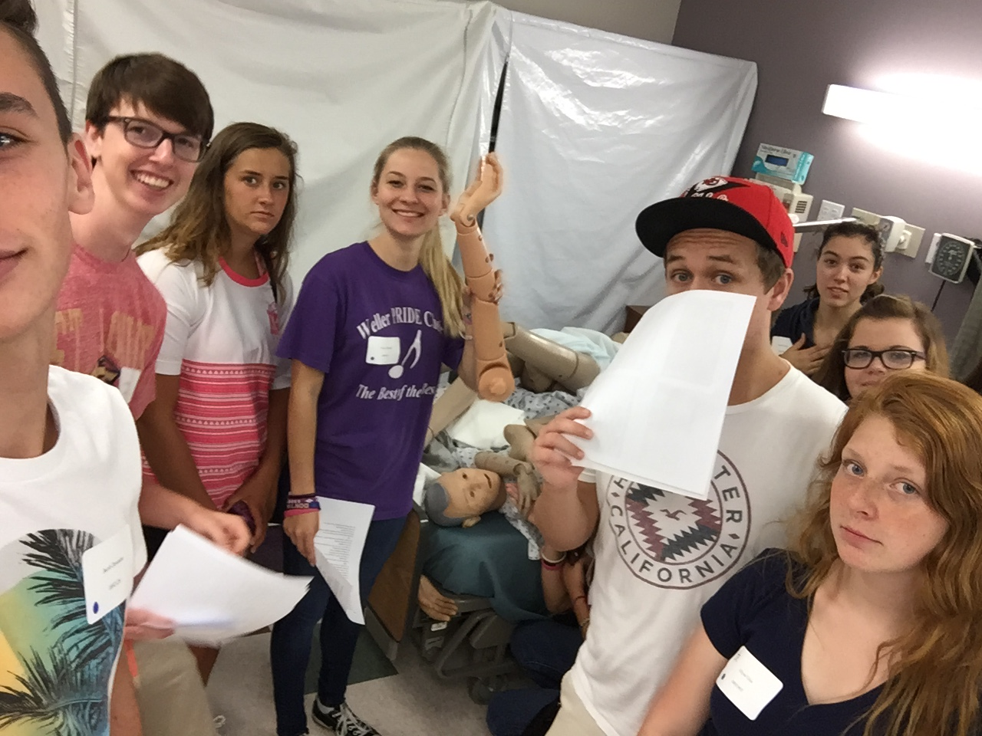
WHEN do Middle College students attend?
Individualize schedule for personal needs
Treated like an adult …check in and out
Participate in internships in career field

Slide 7
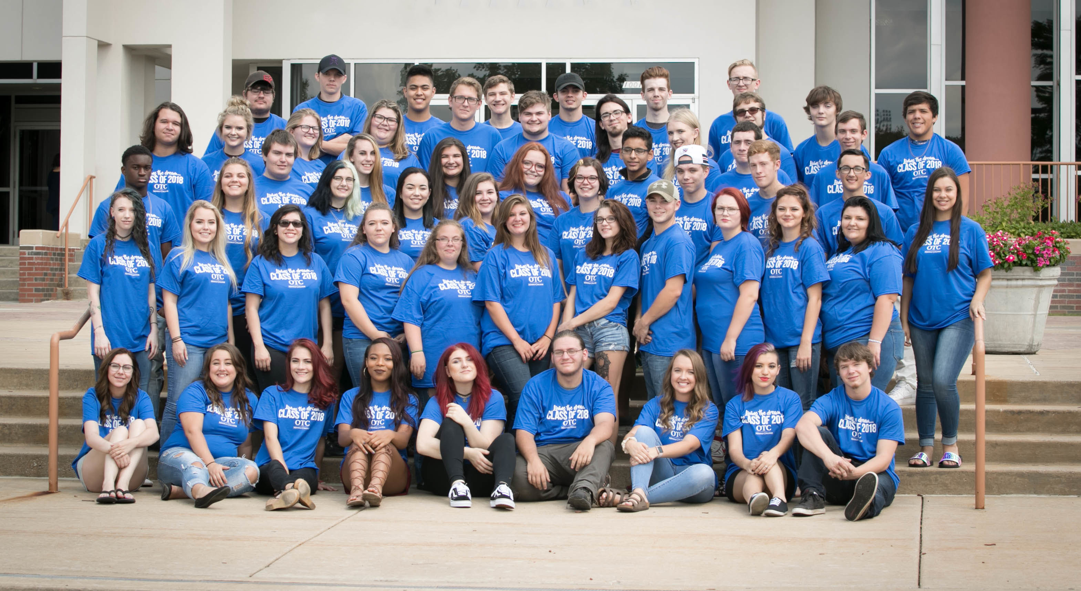
WHY do students select Middle College?
Looking for a different high school experience
Want to start college early
Want a new start in school
Want to pick up extra credits
Want to be treated like an adult
Want to be in an accepting culture and smaller school

Slide 8
https://vimeo.com/ozarkstech

Slide 9
More information on Middle College?
https://www.otc.edu
Call our office 417-447-6997
Questions?
brunnert@otc.edu
417-447-6997

