Slide 2
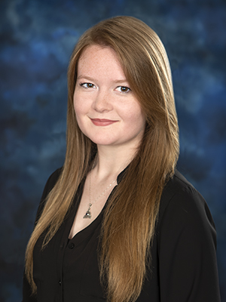
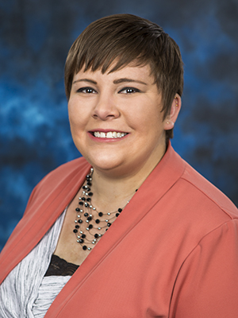
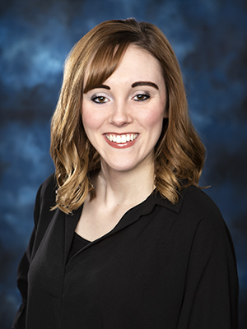
Mackenzie Steelman
Admissions Representative
417-447-2621
steelmam@otc.edu
Jordan Schreiber
Director of Recruitment
417-447-6904
schreijo@otc.edu
Katelyn Mills
Admissions Representative
417-447-6902
millska@otc.edu

Slide 3
A little bit about otc…
OTC is the fastest growing community college in the state.
OTC currently has around 11,000 students enrolled in classes.
OTC keeps tuition costs low so our students don’t have to go into immense debt to get a degree.
We offer a wide variety of financial aid to help our students focus on what’s most important, their education.

Slide 4
Reasons to love otc
Affordability
Area’s lowest tuition
Employability
Convenience
Day, evening, weekend, and online classes
Small Class Sizes
Average class size is 17
Something for everyone
Associate degree vs. Certificate
Allied Health vs. Tech Ed. vs. Transfer
Great Resources
Free tutoring, computer labs, writing center, fitness center, library, etc.
First-Class Faculty
Locations
Springfield, Nixa, Hollister, Waynesville, Lebanon, Republic, and Online
Transferability

Slide 5
Programs of study We have something for everyone
Transfer Opportunities
Allied Health
Technical Programs

Slide 6
Transfer degrees
Associate of Arts
General Education
Behavioral Science
Business
Criminal Justice
English
Social Work
Teaching
Associate of Science
Biological Clinical Science
Biology
Chemistry
Computer Science
Engineering
Fire Service Administration
Mathematics
Pre-Pharmacy

Slide 7
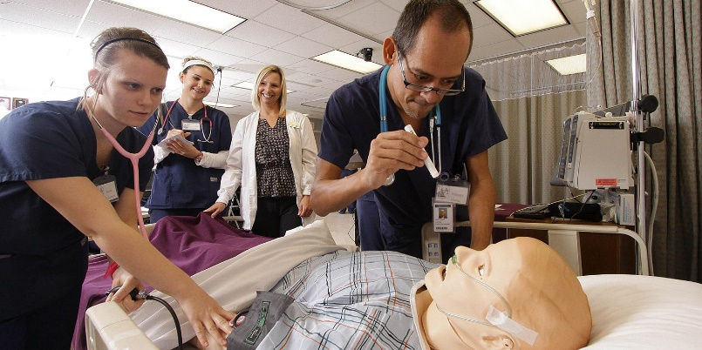
Allied health
Associate of Applied Science
Behavioral Health Support
Dental Assisting
Dental Hygiene
Emergency Medical Services – Paramedic
Health Information Technology
Hearing Information Science
Medical Laboratory Technician
Occupational Therapy Assistant
Physical Therapy Assistant
Respiratory Therapy
Surgical Technology
Associate of Science in Nursing
Certificate of Achievement
Dental Assisting
Emergency Medical Services
Health Information Technology – Coding
Hearing Instrument Science
Practical Nursing
Surgical Technology

Slide 8
Technical Education
Accounting and Business Management
Agriculture – Turf and Landscape Management
Agriculture
Animal Science, Plant Science, General Agriculture
Auto Collison Repair
Automotive Technology
Aviation Flight Technology
Business and Marketing
Computer Information Science
Construction Technology
Culinary Arts
Diesel Technology
Drafting and Design
Early Childhood Development
Electrical Distribution Systems
Electronic Media Production
Fire Science Technology
Graphic Design Technology
Heating, Refrigeration and Air Conditioning
Hospitality Management
Industrial Systems Technology
Manufacturing Technology
Networking Technology
Precision Machining Technology
Remanufacturing Technology
Welding Technology

Slide 9
Career coach
Discover majors and in-demand careers and education based on your interests.
otc.emsicc.com

Slide 10
Financial aid Show me the money!
Types of Financial Aid
Free Money
Grants (Federal and State)
Most common: Pell Grant (need-based grant)
Missouri A+ Program
Scholarships
Work Study
Not Free Money
Student Loans

Slide 11
How Do I apply for financial Aid?
Step 1: Create an FSA ID
What is an FSA ID?​
A username and password that you must use to log into certain U.S. Department of Education websites​
Why do I need one?​
The FSA ID is used to sign legally binding documents electronically​
Where do I create an FSA ID?​
Go to fsaid.ed.gov

Slide 12
How Do I apply for financial Aid?
Step 2: Fill out the FAFSA
FAFSA = Free Application for Federal Student Aid​
Why should I fill out the FAFSA?​
The FAFSA is your application for financial aid. It qualifies you to receive grants, scholarships, and student loans.​
How do I fill out the FAFSA?​
Go to studentaid.gov
The 2021-2022 FAFSA for fall 2021 enrollment will be available October 1

Slide 13
the a+ scholarship
OTC has the largest number of A+ recipients in the state of Missouri!
If you are a student who completes the requirements for the A+ program, your tuition and common fees will be covered at OTC!
To receive A+, you must be enrolled as a full-time student (12+ credit hours per semester) and maintain a 2.5 cumulative GPA.
A+ does not cover the cost of books or course-specific fees. You can stack scholarships on top of your A+ scholarship to help reduce what you are having to pay out-of-pocket.

Slide 14
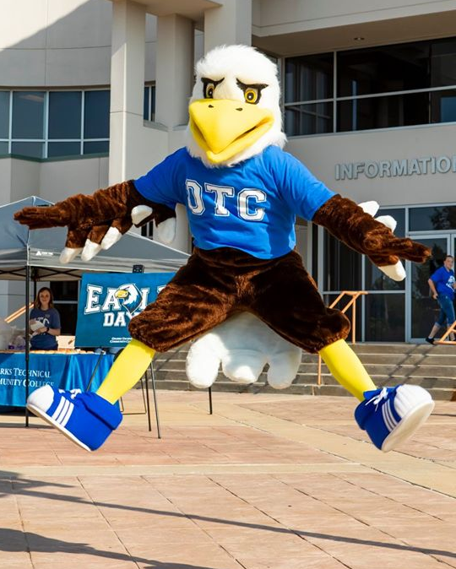
How to use A+ at otc
Apply for Admission to OTC
Submit an official high school transcript after you graduate
Be degree-seeking at OTC
Enroll as a full-time student
Complete the FAFSA and list OTC as a school to receive info

Slide 15
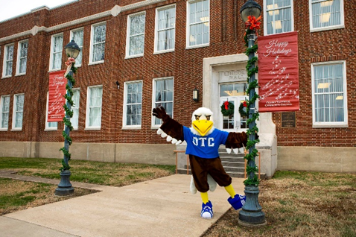
Our Admissions Process Is Simple:
1. Submit a free online application at apply.otc.edu.
2. Complete the FAFSA.
3. Send your official high school transcript to OTC after you graduate.
4. Complete Guided Self-Placement. (No ACT or SAT scores required!)
5. Attend a STAR seminar.
6. Last but not least, register for classes and officially become an OTC eagle.
That’s It!

Slide 16
Check US out
Despite being a commuter college, OTC works hard to provide our students with a traditional college experience!
OTC continues to grow and expand. You never know what is coming next! Stay tuned so you don’t miss out.
Follow Ozarks Technical Community College on Twitter, Instagram, Facebook, and Snapchat to be informed on what’s happening around the college.

Slide 17
Mackenzie Steelman
Admissions Representative
417-447-2621
steelmam@otc.edu
Jordan Schreiber
Director of Recruitment
417-447-6904
schreijo@otc.edu
Katelyn Mills
Admissions Representative
417-447-6902
millska@otc.edu

